Slide 1
Lecture 12 Web Scraping
Bryan Burlingame
24 April 2019

Slide 2
Announcements
Code review sign up posted
Homework 9 posted
All labs can be performed in groups of up to three starting this week

Slide 3
Learning Objectives
Discuss modules and automation
Introduce web scraping

Slide 4
Modules
Recall: modules are functions and objects which can be used across programs
Modules reside within one namespace and are imported with the import command
There are literally thousands of libraries of varying quality to accomplish many, many tasks
Math
Systems Automation
Data Analysis
Game Engines
etc. etc. etc.

Slide 5
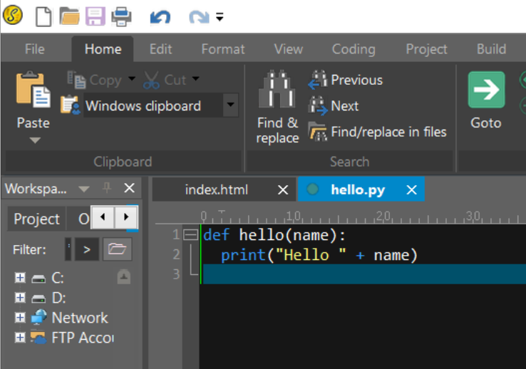
Building Your Own Modules
Most simply, modules are simply Python functions and objects implemented in a different file
It is possible to write modules in other languages
Here is a text file (hello.py) with a simple Python function called hello.
The file was created in a text editor
Notepad++ is linked to on me30.org

Slide 6
Building Your Own Modules
From here, we can import our module just like any module if the module exists in our path
Higher level code reuse
The path is just a list of directories Python uses to find modules

Slide 7
Systems Automation and Web Scraping
One key task frequently handed to Python is systems automation
Systems automation is programmatically repeating some set of functions usually performed by a human
Systems automation is a key productivity differentiator between a good engineer and a great one
Web Scraping is the process of programmatically accessing and reacting to data available from a website
We will use a series of modules to accomplish this
webbrowser – open a browser to a particular page
Requests – Downloads files and web pages from the Internet
Beautiful Soup – Parses HyperText Markup Language (HTML)
All three come with the Anaconda release of Python
Searching for “Python web scraping modules” will give many more

Slide 8
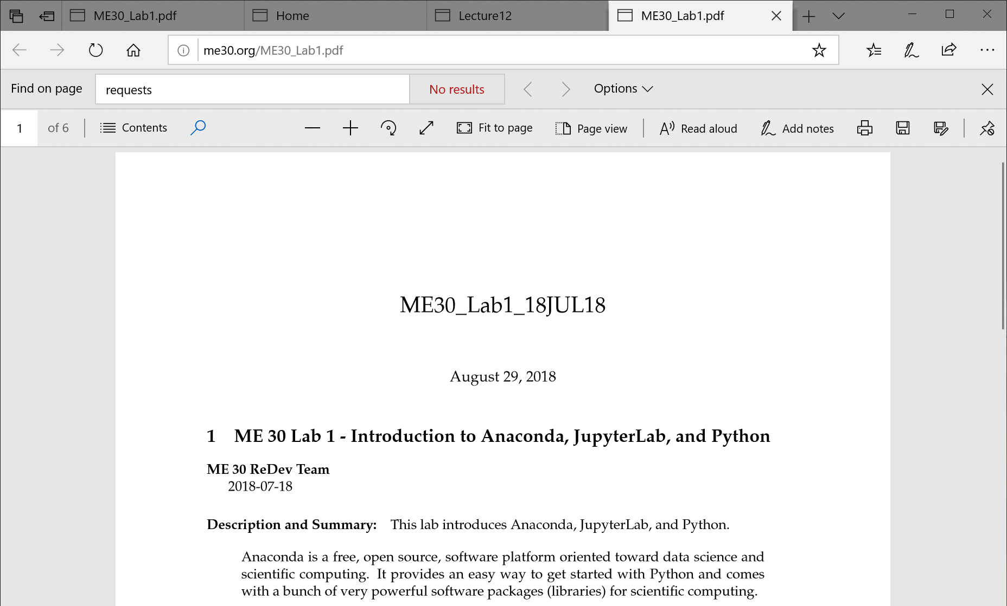
webbrowser
The webbrowser module is very simple
It just sends a request to open a uniform resource locator (URL) in the default system browser
URLs most frequently point to a website

Slide 9
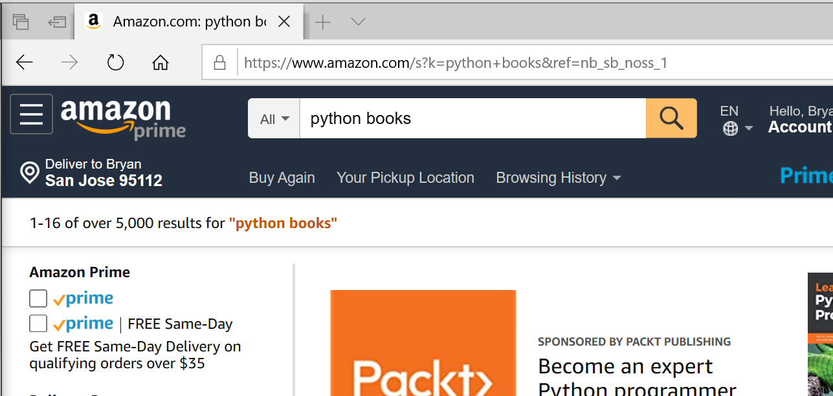
webbrowser
Let’s look at an Amazon search
The resulting URL is https://www.amazon.com/s?k=python+books&ref=nb_sb_noss_1
Most likely, the &ref=nb_sb_noss_1 part is internal, but that s?k parameter is interesting

Slide 10
webbrowser
Let’s create a Python program which asks the user for a search term and then opens Amazon’s page to that term
Steps:
Ask for search term
Format URL
Open site

Slide 11
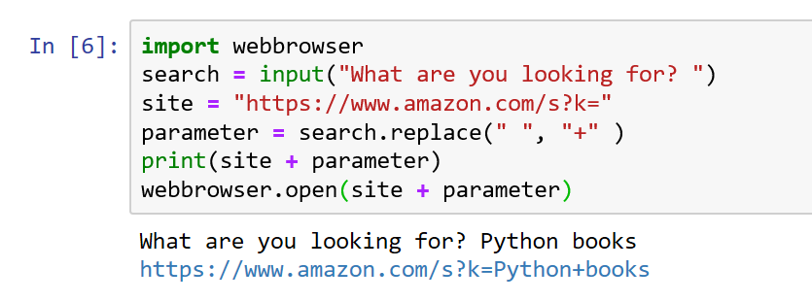
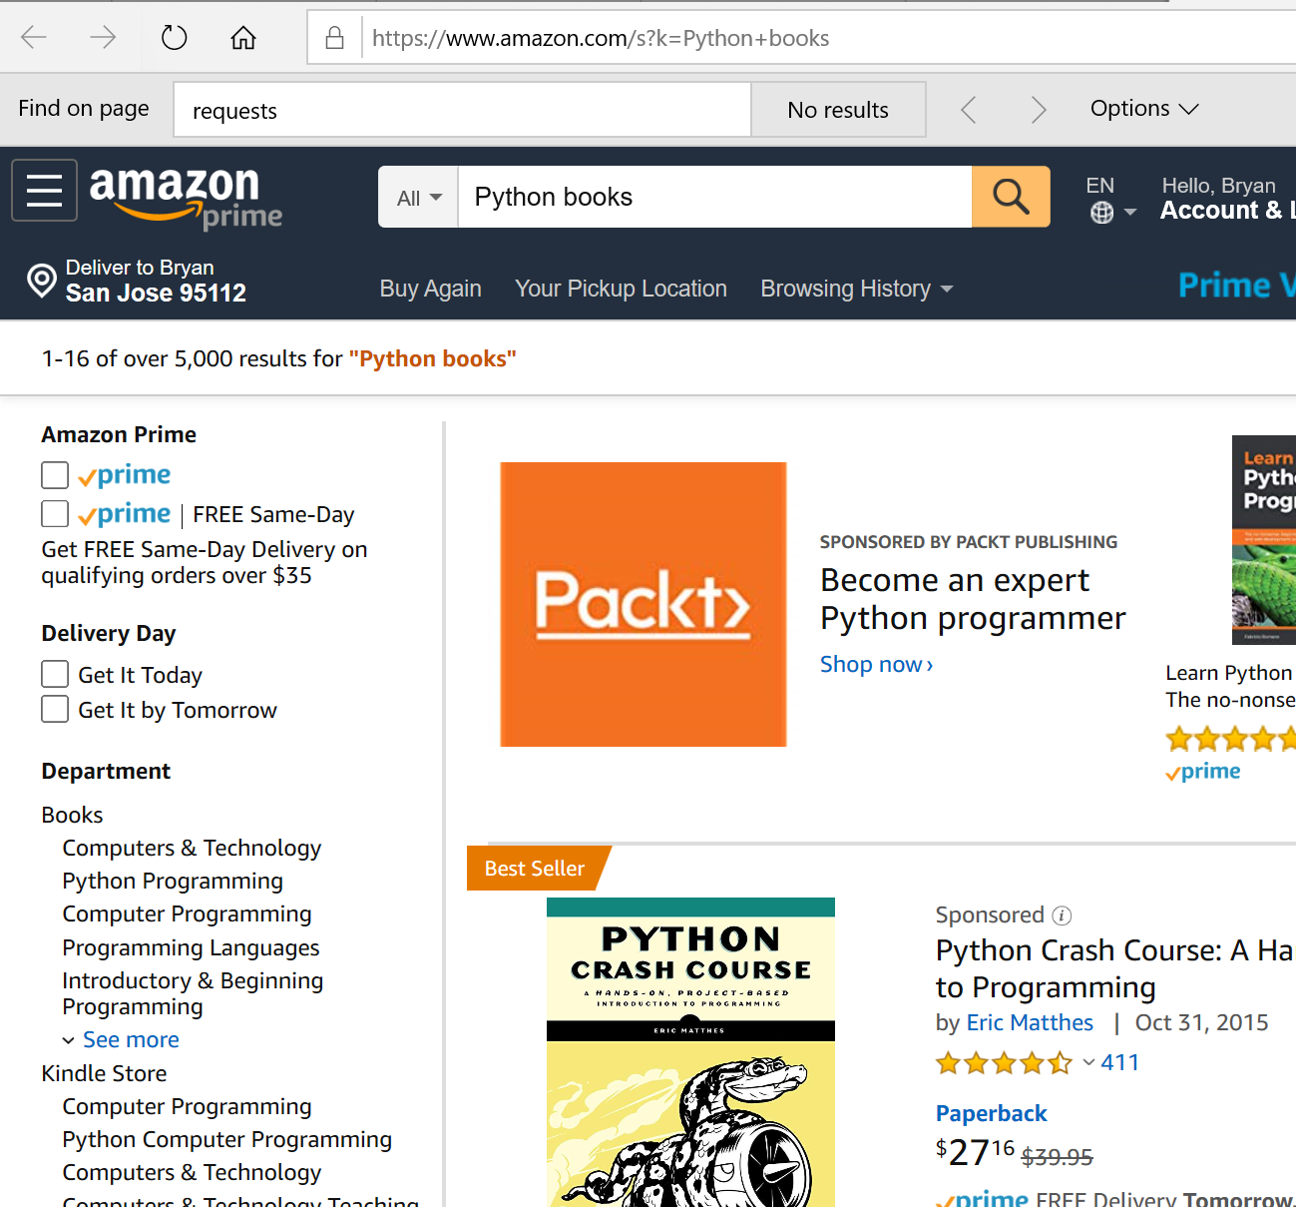
webbrowser
Let’s create a Python program which asks the user for a search term and then opens Amazon’s page to that term
Steps:
Ask for search term
Format URL
Open site
Even with just a simple function, a bit of analysis and the tools we already have can create interesting tools

Slide 12
Requests
Requests is a rich module to request web pages over the hypertext transport protocol (http)
https://2.python-requests.org/en/master/
Primary purpose is to obtain the contents of a web page

Slide 13
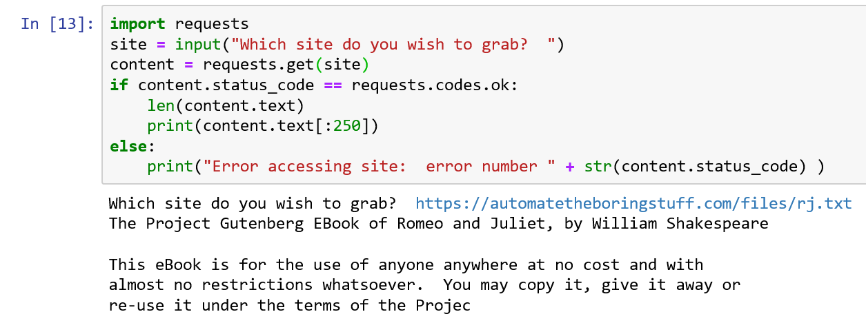
Requests
import requests
Use the get method to obtain the html which comprises the website
This example is a site with just text

Slide 14
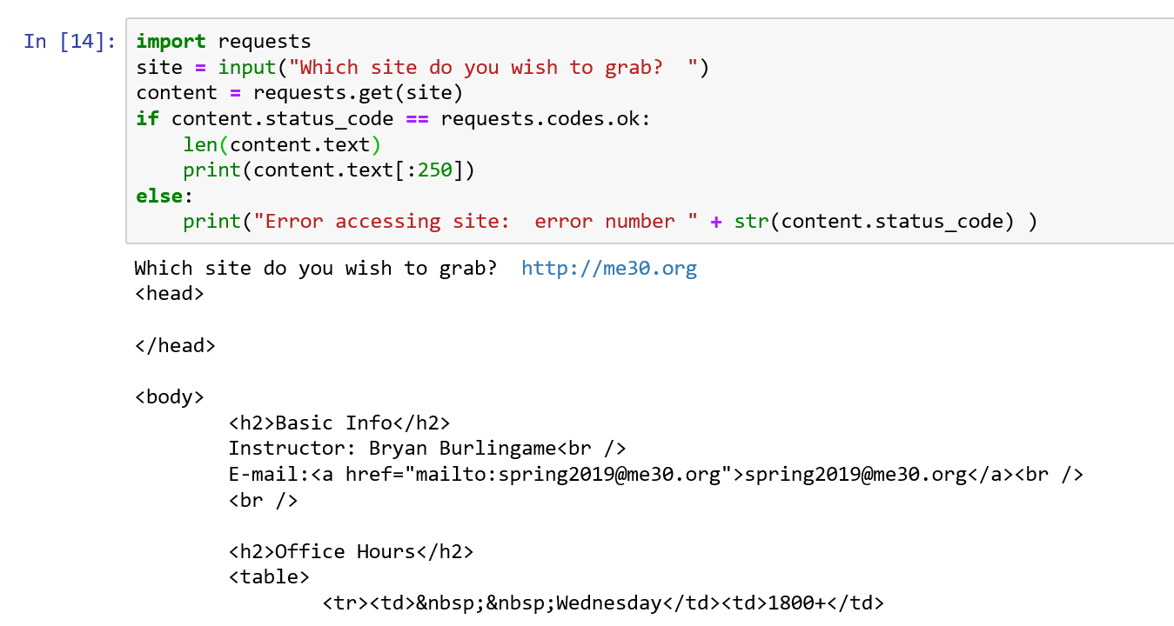
Requests
import requests
Use the get method to obtain the html which comprises the website
When the site is constructed of HTML,

Slide 15
HTML Basics
Hypertext Markup Language is the language websites are constructed with
They are comprised of text surrounded by tags which modify that text
<strong>Hello</strong> world
Hello world
Hypertext refers to the ability to link pages together using the anchor tag
<a href=“http://me30.org”>ME 30’s Website</a>
Will create a link http://me30.org called ME 30’s Website
Many of these elements will have descriptors, such as ID which will allow us to search for the element and then act upon finding it

Slide 16
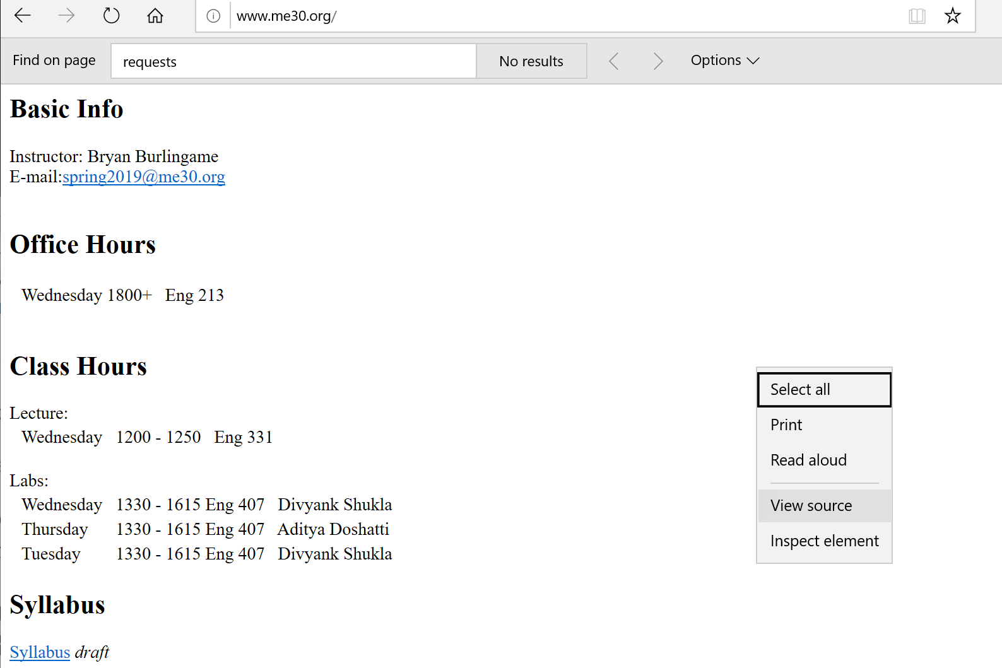
View HTML Source
All major web browsers allow you to look at the source code underlying the site
Right click and choose “View Source”

Slide 17
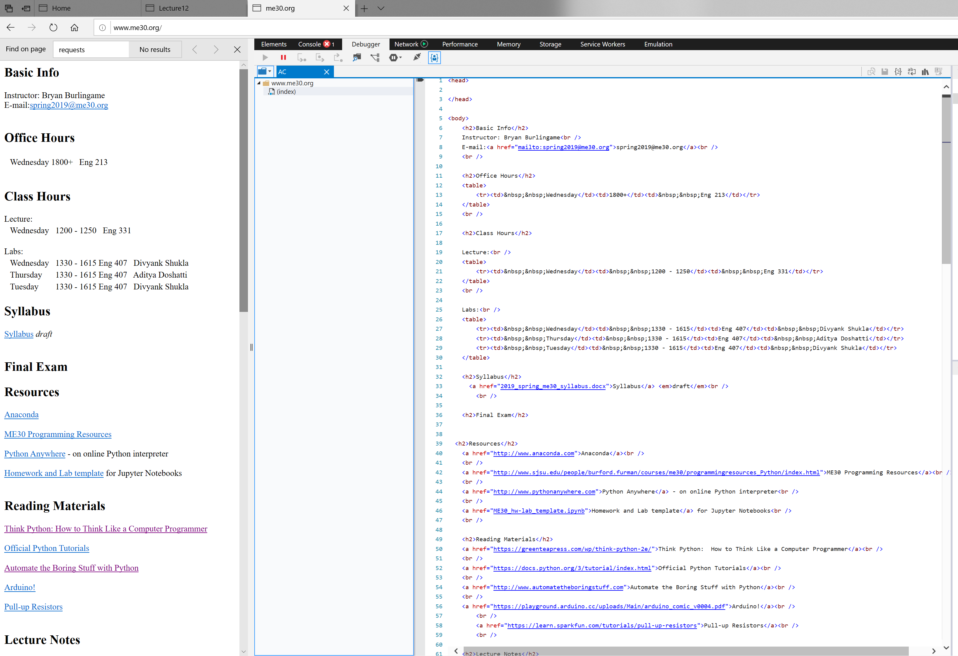
Rendered HTML
Raw HTML

Slide 18
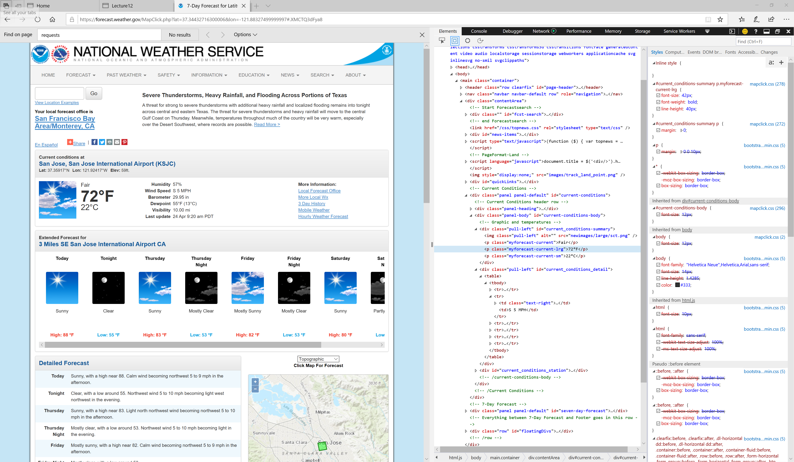
Inspect Element

Slide 19
Beautiful Soup
Searching through html using string tools or regular expressions is difficult and error prone
Beautiful Soup is a library to parse the html of a website and allow us to search through the html elements
https://www.crummy.com/software/BeautifulSoup/
Frequently used with Requests
Requests fetches the HTML
Beautiful Soup makes it useful

Slide 20
Beautiful Soup
Beautiful Soup breaks down the structure of a website into a searchable collection of objects
Obtain the html with Requests
Soupify the html with the BeautifulSoup method
Creates a BeautifulSoup object
Use the select method to extract the collection of data of interest

Slide 21
Beautiful Soup
Extract the current temperature
Notice that the temp is in a P element with class “myforecast-current-lrg”
The temp itself is the text within that tag
Needed:
Get the site source
Extract the tag with class myforecast-current-lrg
Display the text associated with that tag

Slide 22
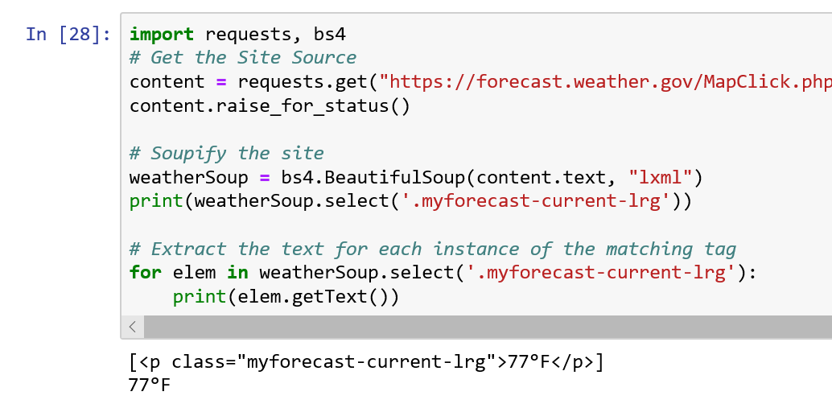
Beautiful Soup
Get the site source
Extract the tag with class myforecast-current-lrg
Display the text associated with that tag
https://forecast.weather.gov/MapClick.php?lat=37.34432716300006&lon=-121.88327499999997

Slide 23
Beautiful Soup .select
There are many select parameters
soup.select(‘tag’): returns all <tag></tag> elements
soup.select(‘#identifier’): returns all elements with id “identifier”
soup.select(‘.class’): returns all elements with class “class”
We used this in the previous example to extract myforecast-current-lrg
soup.select(‘div span’): html can be hierarchial, with one tag within another, this returns the set of span elements which exist within div tags
There are many others, refer to the text or the Beautiful Soup documentation

Slide 24
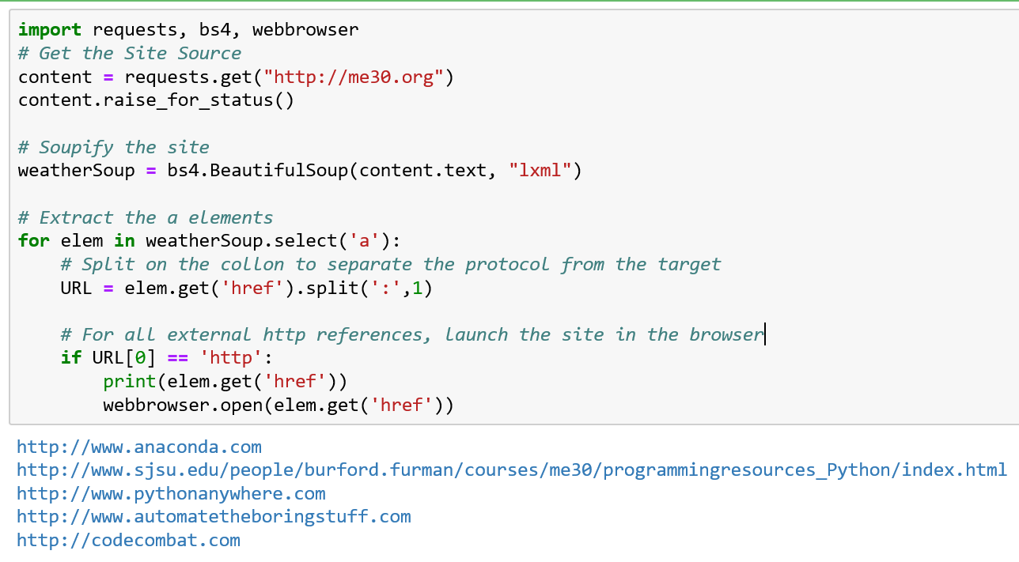
Pull it all together
Extract all of the hyperlinks from a site and launch each external site in a different browser tag

Slide 25
Resources
Downey, A. (2016) Think Python, Second Edition Sebastopol, CA: O’Reilly Media
(n.d.). 3.7.0 Documentation. 5. Data Structures — Python 3.7.0 documentation. Retrieved October 30, 2018, from https://docs.python.org/3/tutorial/datastructures.html

